Slide 1



Automated
Image Generation
Hill Seah Wen Qi (U2121346H)
Project ID
Project Supervisor
CCDS24-0163
Associate Professor Lu Shijian
Examiner
Associate Professor Lin Guosheng

Slide 2



Outline
Research Scope
Introduction
Motivation
Objectives

Slide 3



Research Scope
FYP Title ⟶ FYP Research Scope
Automated ⟶ Training-Free
Automated Generation implies minimal human input
Chosen training-free methods
Training-free take automation further by removing the need for retraining on new data or conditions
This increases practicality, reduces computational costs, and supports rapid adaptation to new generation tasks

Slide 4

Research Scope
FYP Title ⟶ FYP Research Scope
Image Generation ⟶ Multi-conditional Image Generation (Diffusion Models)
Chosen multi-conditional generation, where multiple attributes or conditions guide the image output
Chosen diffusion models as the primary image generation network as they offer strong controllability and high image quality

Slide 5




Motivation
Challenges of Training-Free Multi-Conditional Generation
Independent Condition Optimization
Conflicting Guidance Signals
Lack of Joint Condition Satisfaction
Most methods optimize each condition separately, assuming independence — this neglects semantic interactions, leading to incoherent or conflicting outputs [6]
Without a learned fusion mechanism, different conditions may pull the generation in different directions, degrading
visual fidelity [8]
Existing methods struggle to enforce joint constraint satisfaction, especially when conditions interact non-trivially [21]

Slide 6


Objectives
Create a flexible base solution for training-free multi conditional image generation
Base solution should be able to handle multiple conditions and remain training-free even when new conditions are added
Base solution should be flexible and open to enhancements (for example in Objective 2)
Solve the problem of the lack of handling of complicated and non-linear interactions between multiple potentially dependent conditions

Slide 7


Outline
Conditional Score Based Diffusion Models
Literature Review
Energy Diffusion Guidance
Approximating Time-Dependent Energy Guidance with Time-Independent Distance Functions

Slide 8
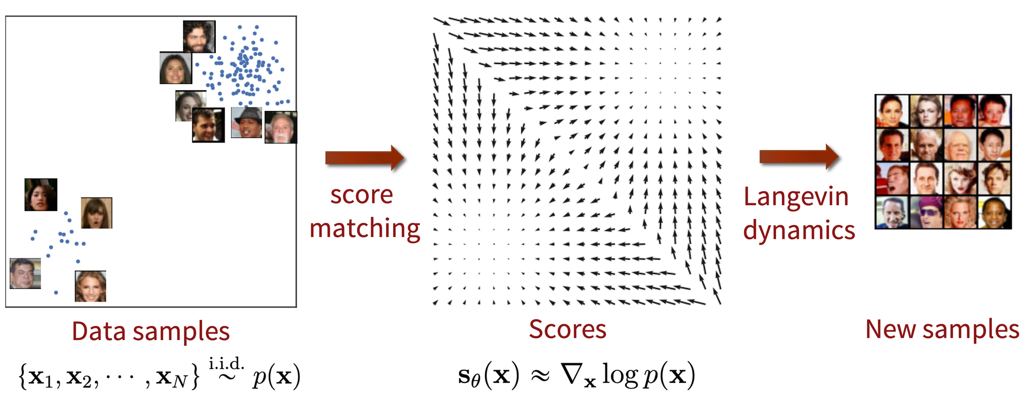
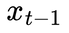

Conditional Score Based Diffusion Models
Unconditional Score-Based Diffusion Models (USBDM)
Operates on score theory
Learn and estimate a time-dependent score function that guides the denoising phase of a noisy image to at time step t during the iterative denoising process [16]
Denoising Formula
Score Function

Slide 9


Conditional Score Based Diffusion Models
Conditional Score-Based Diffusion Models (CSBDM)
A corrective gradient is added to the USBDM denoising formula
The corrective gradient guides to a hyperplane in the data space that aligns with the condition c [16]
Denoising Formula
Corrective Gradient

Slide 10


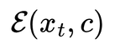
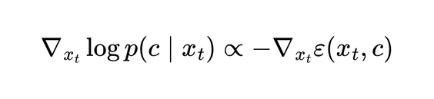

Energy Diffusion Guidance
Alternative method to model the conditional corrective gradient
Energy function, , value decreases as the similarity between
and c increases
Energy function = zero when and c are perfectly similar
Thus, the corrective gradient can be remodelled to energy guidance as
[9]
Final denoising formula with energy diffusion guidance

Slide 11
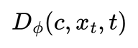
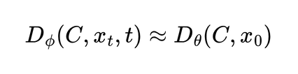
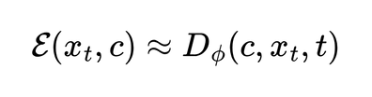
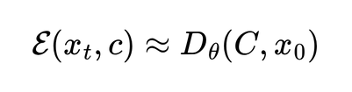
Approximating Time-Dependent Energy Guidance with Time-Independent Distance Functions
Training-Required Methods
Training-Free Methods
Most train classifiers to calculate a Time-Dependent Distance Function between and c
Time-dependent Distance Function then used to approximate the energy guidance function
Approximate the Time-Dependent Distance Function with Time-Independent Distance Functions
Time-Independent Distance Function then used to approximate the energy guidance function
where ϕ represents the trained parameters of the classifier [5]
where θ represents the parameters of a pre-trained classifier [20]

Slide 12



Outline
MATCHE Diffusion
Solutions
Multi-Conditional Time-Independent Approximated Energy Guidance
Approximating Clean Image from Noisy Image
Interaction Modelling

Slide 13


Solutions Overview
MATCHE Diffusion
Multi-conditional
Approximated
Time-independent
Condition-Harmonizing
Energy guidance

Slide 14
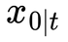
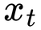
MATCHE DIFFUSION
Multi-conditional Approximated Time-independent Condition-Harmonizing Energy guidance
Main components
Multi-Conditional Approximated Time-Independent Energy Guidance
Base denoising process supporting multiple conditions, while remaining training free
Flexible to enhancements
Clean Image Approximation
Approximation of clean image from noisy image
Interaction Modelling (Condition Harmonizing)
Captures complex, non-linear interdependencies between conditions

Slide 15


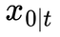

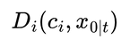
Multi-Conditional Time-Independent Approximated Energy Guidance
No Interaction Modelling
Definition
Example
If represents a text condition, then the pre-trained network i
could be a CLIP embedding model, and could be a Euclidean
distance value between the CLIP embedding of and
Where
represents a given condition i
represents the approximated clean image at time step t
represents the distance between condition i and
computed by a pre-trained network that is specific to condition i
λi represents the weighting factor of

Slide 16


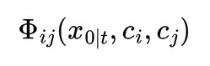
Multi-Conditional Time-Independent Approximated Energy Guidance
With Interaction Modelling
Definition
Where
represents a function that models the interactions
between conditions , and the approximated clean image
in their respective spaces
λij represents the weighting factor of

Slide 17


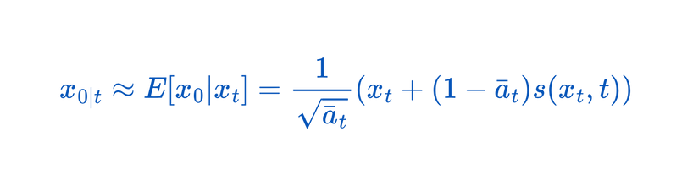


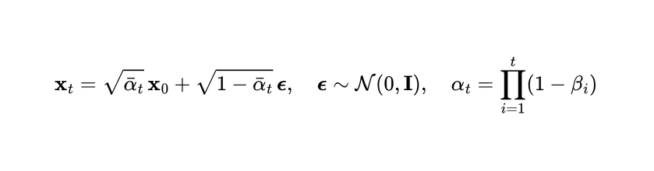

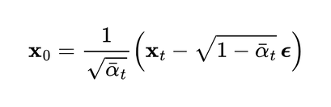

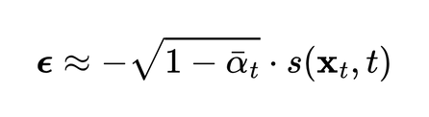
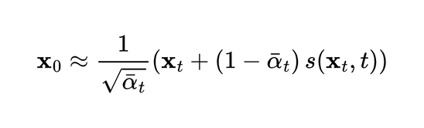

Approximating Clean Image from Noisy Image
Forward Process (Gaussian Noise Addition)
Rearranging to Estimate X0
Since the score-based diffusion model, s(, t) learns to predict ϵ, or its scaled version
Sub (3) in (2)

Slide 18


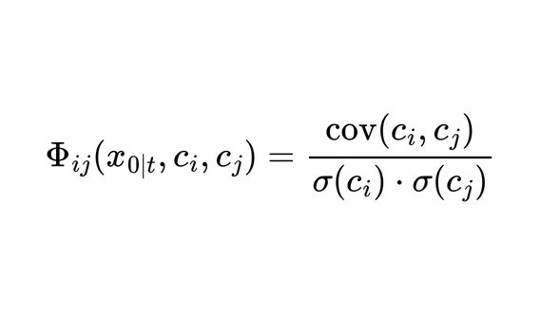
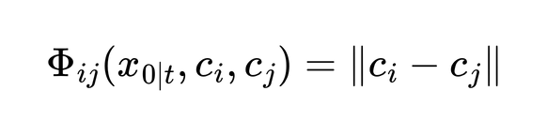
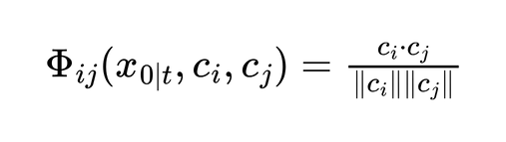
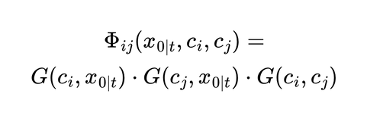
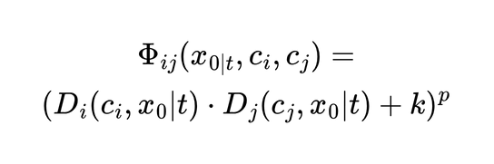
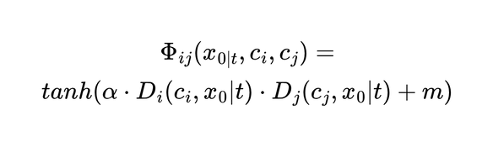
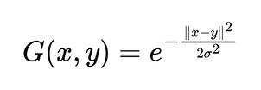
Interaction Modelling
Modelling
in
Euclidean Distance
Cosine Similarity
Pearson Correlation
Polynomial Kernel
Sigmoid Kernel
Gaussian Kernel
where

Slide 19
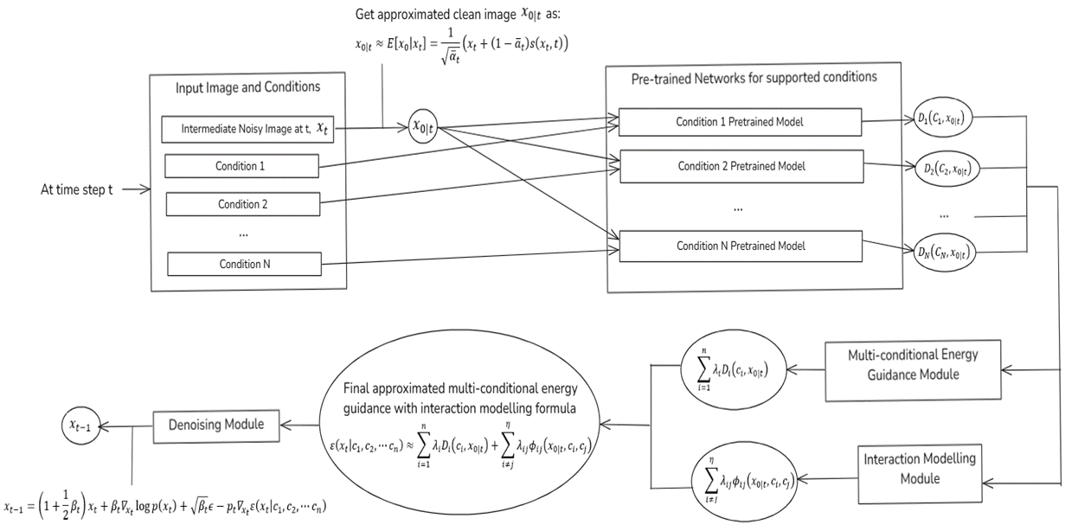
MATCHE Architecture

Slide 20



Outline
Scope
Experimental Setup
Configuration
Experiment Setup

Slide 21
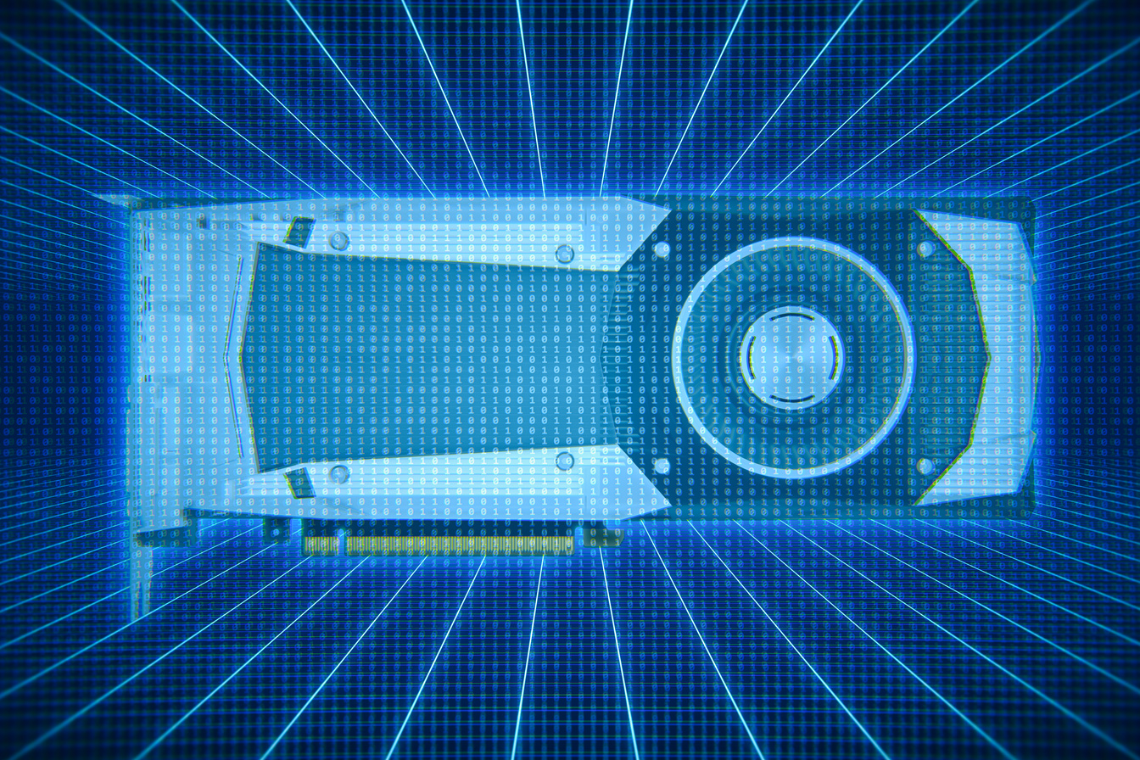
Scope
Image Generation Model
Limitations
Given GPU memory constraints, running larger diffusion models with general image generation capabilities (such as Stable Diffusion or ControlNet) was infeasible
These models require substantial Video Random-Access Memory (VRAM) to store high-dimensional tensors during the iterative denoising process, leading to out-of-memory errors on my available hardware
My NVIDIA GeForce GTX 1660 Ti has 6GB of VRAM, Stable Diffusion and ControlNet requires 8-12GB of VRAM
Chosen Model
Pre-trained unconditional human face diffusion model

Slide 22
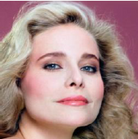
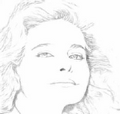
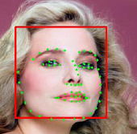
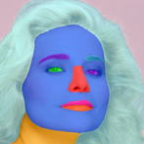
Scope
Conditions (Specific to facial image generation)
Condition | Illustration | Description
Face ID |  | Encodes identity-specific facial features in a numerical representation, ensuring consistency in facial appearance
Sketch |  | Provides a structural outline of the subject, capturing overall shape and contours.
Landmark |  | Defines spatial key points (e.g., eyes, nose, mouth) to enforce geometric accuracy in facial features
Segmentation Map |  | Specifies region-based attributes, guiding the model in differentiating facial parts and background elements
Text |  | Textual prompt that offers high-level semantic descriptions, providing flexible and interpretable guidance for image generation
Text Prompt
= “Wearing Lipstick”

Slide 23

Configuration
Image Generation Model
Unconditional Human Face Diffusion Model [25].
Supports image resolution of 256×256
Pre-trained on human faces in the CelebA-HQ dataset

Slide 24

Configuration
Condition-specific pre-trained model
Condition, ci | Model, fi(x) | Distance i ()
Face ID | Open-source Human Face Identification Network, ArcFace [4] | Euclidean Distance
Sketch | Open-source Sketch-to-Photo Synthesis Network [18] | Euclidean Distance
Landmark | Open-source Landmark Extractor Network [2] | Euclidean Distance
Segmentation Map | Open-source Real-Time Segmentation Network BiSeNet [19] | Euclidean Distance
Text | Open-source CLIP Image and Text Encoder [12] | Euclidean Distance

Slide 25

Experimental Setup
Setup Parameters
Avoid combining conditions with same information
Generated 100 images from each multi-condition group
(Face ID, Landmark, Text)
(Sketch, Landmark, Text)
(Face ID, Segmentation Map, Text)
(Sketch, Segmentation Map, Text)
Evaluation criterion
Average Condition-Specific Euclidean Distances
Average Fréchet Inception Distance (FID)

Slide 26


Outline
Quantitative Results
Results
Qualitative Results

Slide 27
Quantitative Results
Comparison between Interaction Models
 | Text | Text | Facial ID | Facial ID | Segmentation Map | Segmentation Map | Landmark | Landmark | Sketch | Sketch
Interaction Models | FID | Distance | FID | Distance | FID | Distance | FID | Distance | FID | Distance
MATCHE (No Interaction Modelling) | 113 | 21.8 | 158 | 84.1 | 129 | 2331 | 139 | 17.3 | 119 | 329
Euclidean Distance | 163 | 34.9 | 188 | 132 | 146 | 2737 | 136 | 18.9 | 129 | 368
Cosine Similarity | 130 | 24.6 | 144 | 73.5 | 118 | 2147 | 128 | 21.4 | 116 | 317
Pearson Correlation | 149 | 29.2 | 148 | 83.2 | 131 | 2722 | 141 | 16.1 | 131 | 396
Polynomial | 86.2 | 18.0 | 102 | 71.5 | 91.0 | 2174 | 95.3 | 15.3 | 91.4 | 293
Sigmoid | 102 | 21.7 | 118 | 68.4 | 101 | 2272 | 127 | 16.3 | 122 | 322
Gaussian | 74.2 | 13.4 | 86.3 | 58.7 | 77.5 | 1825 | 81.7 | 14.9 | 89.2 | 248

Slide 28
Quantitative Results
TediGAN Baseline Comparison
To further validate the effectiveness of MATCHE diffusion, we compared MATCHE diffusion with Gaussian Kernels, with the baseline model TediGAN.
TediGAN is a multi-modal image generation framework that enables text-guided synthesis through StyleGAN inversion and visual-linguistic similarity learning [17]
 | Text | Text | Facial ID | Facial ID | Segmentation Map | Segmentation Map | Landmark | Landmark | Sketch | Sketch
Interaction Models | FID | Distance | FID | Distance | FID | Distance | FID | Distance | FID | Distance
TediGAN [17] | 71.9 | 12.8 | 82.8 | 59.0 | 81.2 | 2073 | 87.0 | 19.4 | 89.2 | 248
MATCHE | 74.2 | 13.4 | 86.3 | 58.7 | 77.5 | 1825 | 79.7 | 14.9 | 98.2 | 288

Slide 29
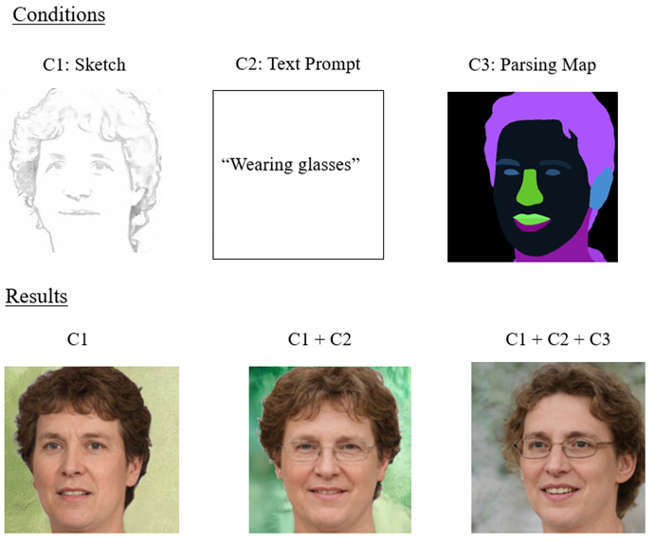
Qualitative Results
Illustration of Sequential Multi-Conditional Image Generation by MATCHE Diffusion
Shows a sequence of image generation to better illustrates MATCHE's ability to integrate multiple conditions progressively
In this example:
(Sketch → Sketch + Text Prompt → Sketch + Text Prompt + Segmentation Map)
This demonstrates how MATCHE's ability to add additional constraints and refine the output while preserving visual coherence

Slide 30
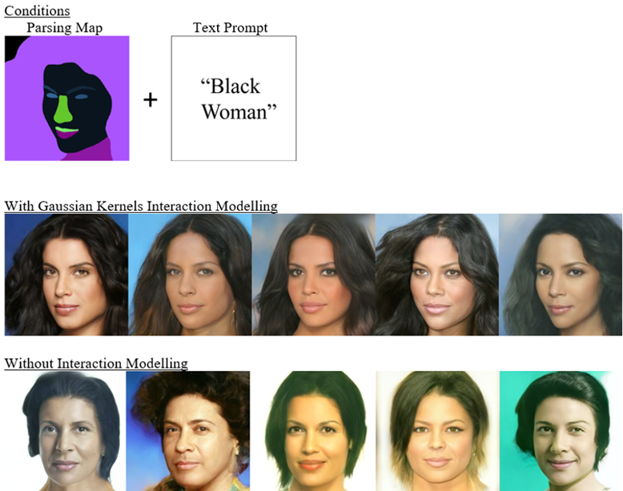
Qualitative Results
Segmentation Map + Text Prompt,
Multi-Conditional Image Generation Result

Slide 31
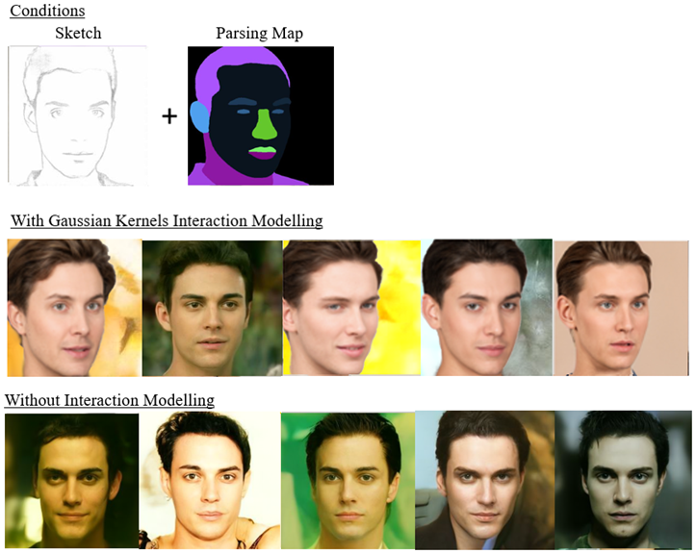
Qualitative Results
Sketch + Segmentation Map,
Multi-Conditional Image Generation Result

Slide 32
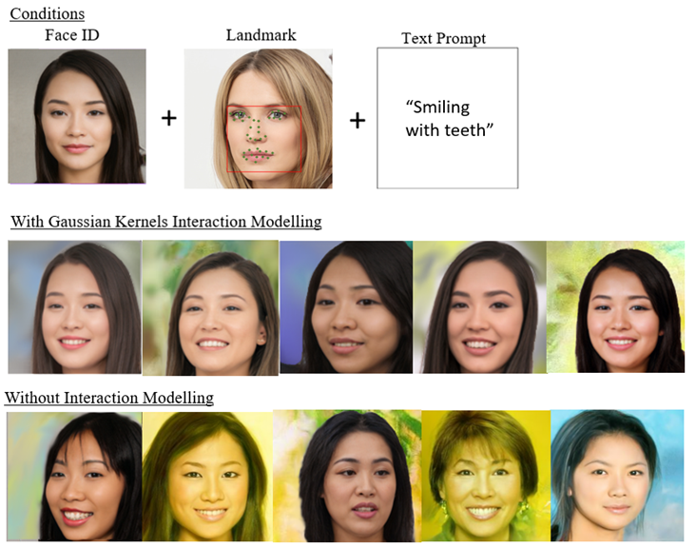
Qualitative Results
Face ID + Landmark + Text Prompt,
Multi-Conditional Image Generation Result

Slide 33
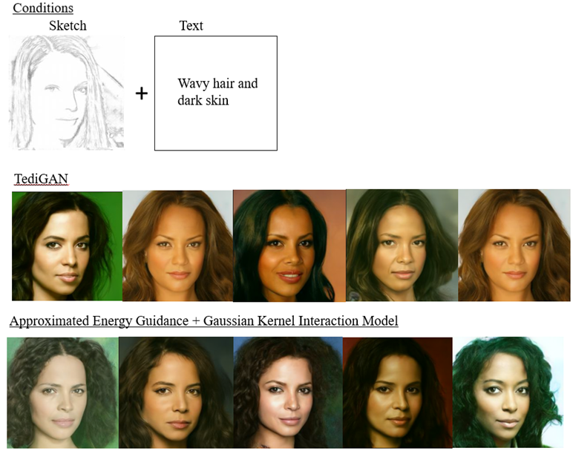
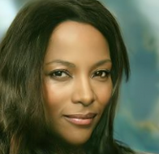
Qualitative Results
Baseline Comparison: Sketch + Text Prompt
MATCHE

Slide 34


Outline
Results Evaluation
Evaluation
Future Work

Slide 35

Results Evaluation
Interation Modelling
Interaction modelling greatly improves quality of images
Seen from lower FID and improved visual fidelity
Gaussian kernels performing the best
Baseline Comparison
MATCHE remains competitive with state-of-the-art networks like TediGAN
Highlights the potential of incorporating MATCHE into existing training-free multi conditional methods to improve quality of outputs

Slide 36


Future Work
Anisotropic Gaussian Kernels
Standard Gaussian Kernel
Anisotropic Gaussian Kernel
σi is a fixed value, assumed to be fixed across all dimensions [13]
This is to reduce the hyperparameter search space to address GPU limitations and minimize computational complexity.
However, with the fixed σi, the standard Gaussian Kernel assumes equal influence in all directions, but some conditions (e.g., shape vs. color) influence different aspects of the image
Σ is a predefined diagonal covariance matrix with varying σi values based on the perpetual importance of the different dimensions [1]
This flexibility enables the kernel to capture the anisotropic nature of images, where different features (dimensions) may have different importance or units, requiring different levels of smoothness or variance along each axis [1]
Can potentially add improvements to shape, spatial, and color constraints by ensuring conditions affect only relevant aspects of image features

Slide 37
Future Work
Extensions to 3D Reconstruction
3D reconstruction can be viewed as generating a 3D representation X that best matches multiple observations or constraints.
With any 3D diffusion model, we can incorporate MATCHE into the denoising process as well
(e.g., voxel grid - 3D CNNs, GANs; point cloud - PointNet++)
MATCHE
Where
X: the reconstructed 3D object (e.g., voxel grid, mesh, point cloud)
ci​: different input conditions (e.g., RGB image, silhouette, multi-view images, depth, text)
Di: discrepancy function for each condition (e.g., perceptual distance between projected image and original)
Φij: interaction terms (e.g., consistency between silhouette and text, multi-view alignment)

Slide 38

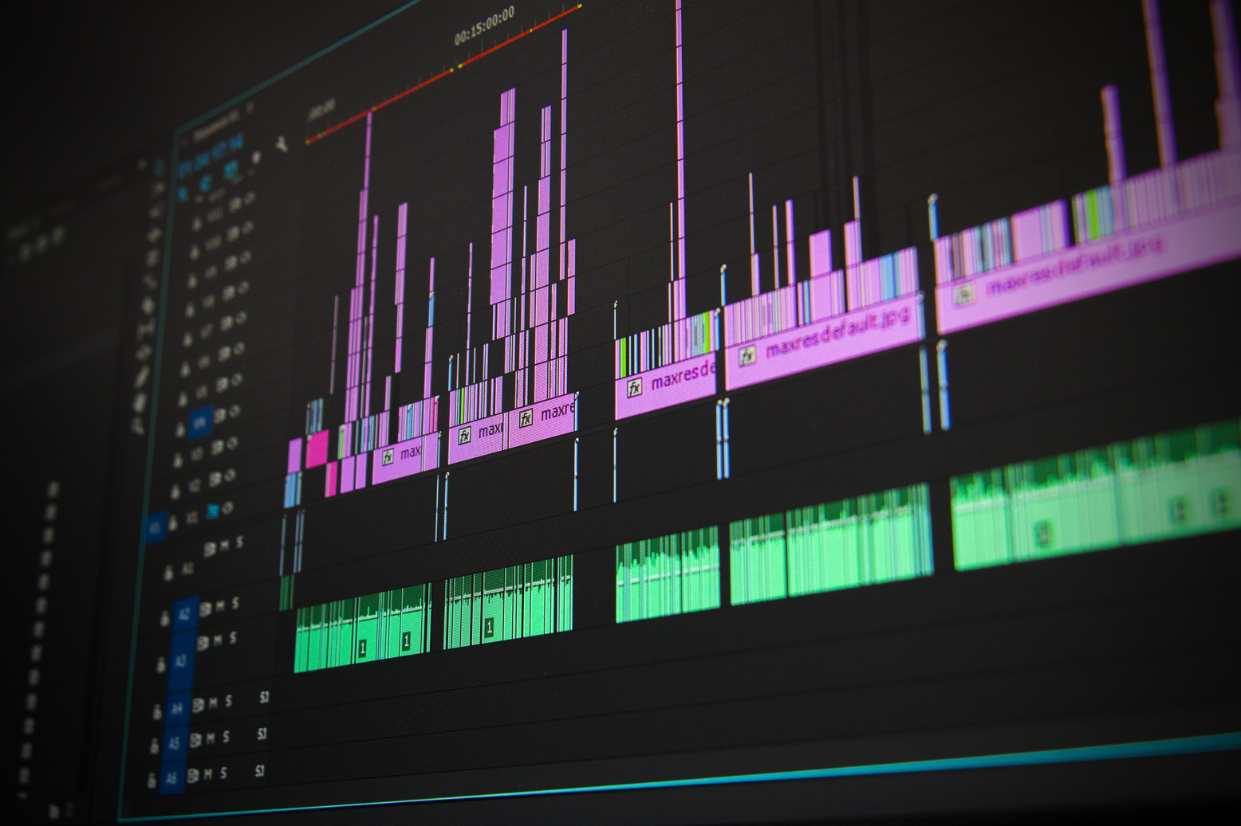
Future Work
Extensions to Video Synthesis
Improved Spatial Energy Guidance
MATCHE can be adapted to energy guidance frame-by-frame in video synthesis
Enhance spatial smoothness by integrating interaction modelling
Modelling these interactions well can ensure smooth transitions, maintain motion coherence, and dynamic content effectively
Enable the generator to produce sequences where each frame is consistent with its neighbors, preserving the continuity and flow necessary for realistic video content

Slide 39
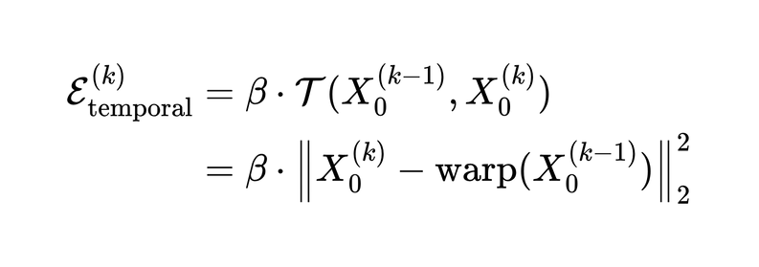
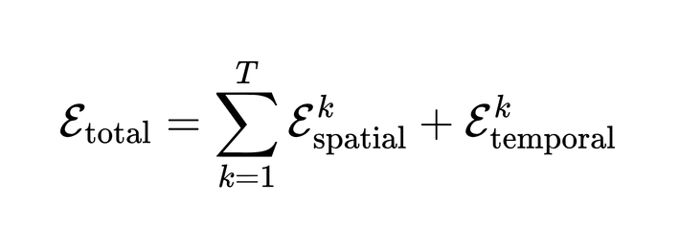
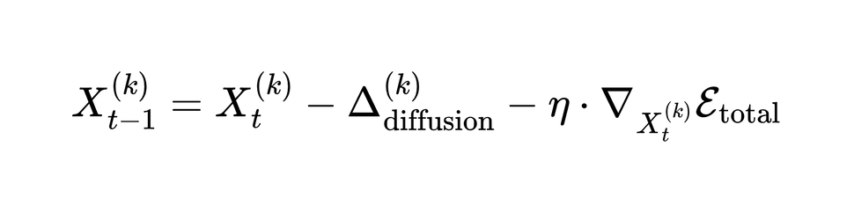
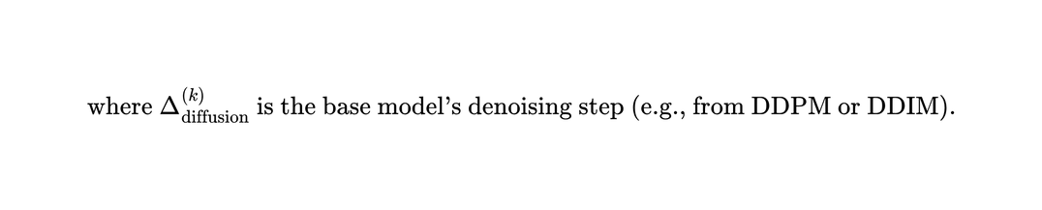
Future Work
Extensions to Video Synthesis
Temporal Energy Guidance (e.g. Optical flow warping loss)
Total Energy Guidance over the Video
Final Denoising Formula
[22]

Slide 40
Conclusion
Proposed Solution
Addressed Key Limitations
MATCHE
Multi-conditional Approximated Time-independent Condition-Harmonizing Energy guidance
Supports multiple conditions
Training-free
Condition harmonization - interaction modelling
Demonstrated Effectiveness
Acknowledged Limitations
Outperformed the TediGAN baseline in some conditions with notable improvements in both qualitative and quantitative metrics.
GPU constraints impacting hyperparameter tuning
Limits the experimental scope
Future Directions
Explore alternative kernel methods for better scaling
Extensions to other generative tasks
3D Reconstruction
Video Synthesis
This project lays a solid foundation for advancements in training-free multi-conditional image generation, opening avenues for more robust generative applications.

Slide 41
References

Slide 42
References
[1] Berry, T., and Sauer, T., 'Local kernels and the geometric structure of data', arXiv, https://doi.org/10.48550/arXiv.1407.1426, 2014.
[2] Chen, C., 'PyTorch Face Landmark: A fast and accurate facial landmark detector', github, https://github.com/cunjian/pytorch_face_landmark, 2021.
[3] Chung, H., Sim, B., and Ye, J. C., 'Come-closer-diffuse-faster: Accelerating conditional diffusion models for inverse problems through stochastic contraction', arXiv, https://doi.org/10.48550/arXiv.2112.05146, 2022.
[4] Deng, J., Guo, J., Xue, N., and Zafeiriou, S., 'Arcface: Additive angular margin loss for deep face recognition', arXiv, https://doi.org/10.48550/arXiv.1801.07698, 2019.
[5] Dhariwal, P., and Nichol, A., 'Diffusion models beat gans on image synthesis', arXiv, https://doi.org/10.48550/arXiv.2105.05233, 2021.
[6] Hertz, A., Mokady, R., Tenenbaum, J., Aberman, K., Pritch, Y., Cohen-Or, D., 'Prompt-to-Prompt Image Editing with Cross Attention Control', arXiv, https://doi.org/10.48550/arXiv.2208.01626, 2022
[7] Hofmann, T., Schölkopf, B., and Smola, A. J., 'Kernel methods in machine learning', arXiv, https://doi.org/10.48550/arXiv.math/0701907, 2008.
[8] Kim, G., Kwon, T., and Ye, J., 'DiffusionCLIP: Text-Guided Diffusion Models for Robust Image Manipulation', arXiv, https://doi.org/10.48550/arXiv.2110.02711, 2021
[9]LeCun, Y., Chopra, S., Hadsell, R., Ranzato, M., and Huang, F., 'A tutorial on energy-based learning', MIT Press, http://yann.lecun.com, 2006.
[10] Lin, H.-T., and Lin, C.-J., 'A study on sigmoid kernels for SVM and the training of non-PSD kernels by SMO-type methods', 2003
[11] Meng, C., He, Y., Song, Y., Song, J., Wu, J., Zhu, J.-Y., and Ermon, S., 'SDEdit: Guided image synthesis and editing with stochastic differential equations', arXiv, https://doi.org/10.48550/arXiv.2108.01073, 2022.

Slide 43
References
[12] Radford, A., Kim, J. W., Hallacy, C., Ramesh, A., Goh, G., Agarwal, S., Sastry, G., Askell, A., Mishkin, P., Clark, J., et al., 'Learning transferable visual models from natural language supervision', arXiv, https://doi.org/10.48550/arXiv.2103.00020, 2021.
[13] Rasmussen, C. E., and Williams, C. K. I., 'Gaussian processes for machine learning', MIT Press, https://doi.org/10.7551/mitpress/3206.001.0001, 2006.
[14] Schölkopf, B., & Smola, A. J., ‘Learning with kernels: Support Vector Machines, regularization, optimization, and beyond.’, MIT Press, https://doi.org/10.7551/mitpress/4175.001.0001, 2001
[15] Shawe-Taylor, J., and Cristianini, N., 'Kernel methods for pattern analysis', Cambridge University Press, https://doi.org/10.1017/CBO9780511809682, 2004.
[16] Song, Y., Sohl-Dickstein, J., Kingma, D. P., Kumar, A., Ermon, S., and Poole, B., 'Score-based generative modelling through stochastic differential equations', arXiv, https://doi.org/10.48550/arXiv.2011.13456, 2021.
[17] Xia, W., Yang, Y., Xue, J.-H., and Wu, B., 'TediGAN: Text-guided diverse face image generation and manipulation', arXiv, https://doi.org/10.48550/arXiv.2012.03308, 2021.
[18] Xiang, X., Liu, D., Yang, X., Zhu, Y., Shen, X., and Allebach, J. P, 'Adversarial open domain adaptation for sketch-to-photo synthesis', arXiv, https://doi.org/10.48550/arXiv.2104.05703, 2022.
[19] Yu, C., Wang, J., Peng, C., Gao, C., Yu, G., and Sang, N., 'Bisenet: Bilateral segmentation network for real-time semantic segmentation', arXiv, https://doi.org/10.48550/arXiv.1808.00897, 2018.
[20] Yu, J., Wang, Y., Zhao, C., Ghanem, B., and Zhang, J., 'FreeDoM: Training-free energy-guided conditional diffusion model', arXiv, https://doi.org/10.48550/arXiv.2303.09833, 2023.
[21] Zhang, L., Rao, A., Agrawala, M., 'Adding Conditional Control to Text-to-Image Diffusion Models', arXiv, https://doi.org/10.48550/arXiv.2302.05543, 2023.
[22] Zhang, Y., Zhao, D., Luo, Z., Chen, D., Huang, Y., Wang, L., Shen, Y., Zhou, J., Tan, T., 'VideoFusion: Decomposed Diffusion Models for High-Quality Video Generation', arXiv, https://doi.org/10.48550/arXiv.2302.05543, 2023.

Slide 44
Thank You!
Special thanks to my project supervisor, Professor Lu Shijian, and my student mentor, Xu Muyu, for their invaluable guidance and support throughout this journey!

Slide 45
Q&A

Slide 46
Appendix

Slide 47
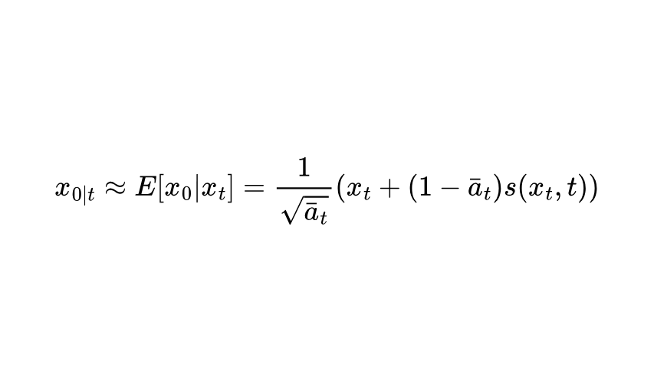
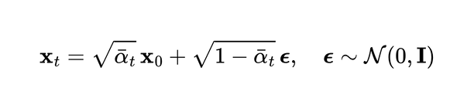
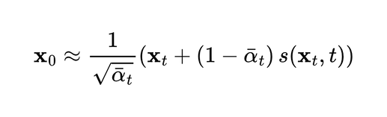
Appendix 1
Derivation of Approximating Clean Image X{0 | t} from Noisy Image X{t}
(1) Forward Process (Gaussian Noise Addition)
(2) Rearranging to Estimate X0
(3) Since the score-based diffusion model learns to predict ϵ, or its scaled version
(4) Sub (3) in (2)

Slide 48
Appendix 2
Experimental Setup - Multi-Conditional Groups Combination
Classified conditions into similar groups based on the type of information they provide
Group | Description | Conditions
Structural Representation | Defines the specifics of the shape and structure of the facial subject | Face ID, Sketch
Spatial Feature | Describes locations of key points and regions | Landmark, Segmentation Map
Semantic Description | Provides high-level conceptual information | Text

Slide 49
Appendix 3
Models
Characteristics \ Technique | Euclidean Distance | Cosine Similarity | Pearson Correlation | Polynomial Kernel | Sigmoid Kernel | Gaussian Kernel
Captures linear relationships | ✅ | ✅ | ✅ | ✅ | ✅ | ✅
Captures non-linear relationships | ❌ | ❌ | ❌ | ✅ | ✅ | ✅
Invariant to vector magnitudes | ❌ | ✅ | ✅ | ❌ | ❌ | ✅
Sensitive to spatial structure | ✅ | ❌ | ❌ | ✅ | ❌ | ✅
Suitable for high-dimensional data | ❌ | ✅ | ❌ | ✅ | ✅ | ✅
Captures complex interactions | ❌ | ❌ | ❌ | ✅ | ✅ | ✅
Computational cost | ✅ | ✅ | ✅ | ❌ | ❌ | ❌
Robust to noise or scale variance | ❌ | ✅ | ✅ | ❌ | ❌ | ✅

Slide 50
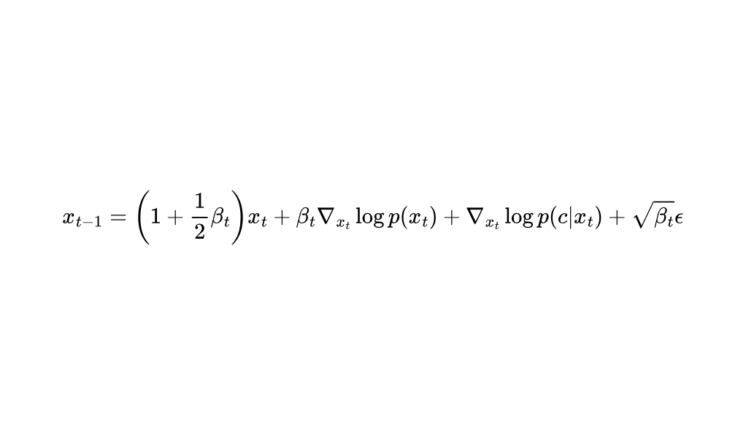
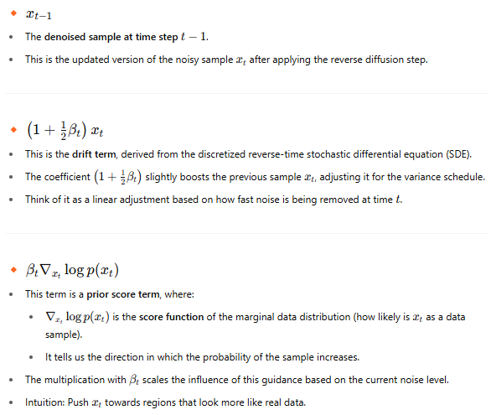
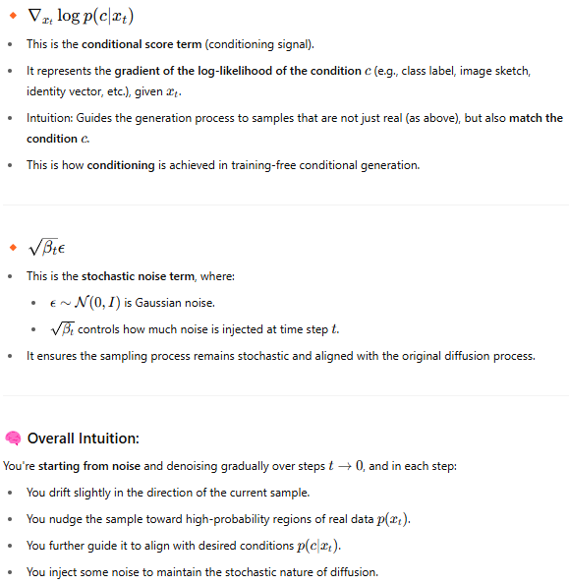
Appendix 4
Conditional Score Based Diffusion Models

Slide 51
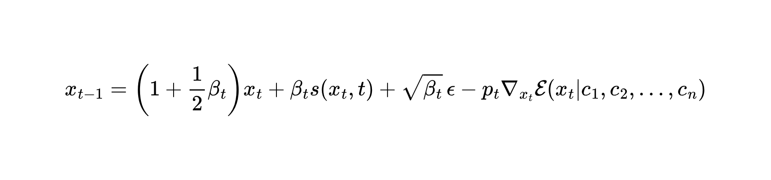
Appendix 5
Diffusion
betas = get_beta_schedule(
beta_schedule="linear",
beta_start=0.0001,
beta_end=0.02,
num_diffusion_timesteps=1000,
)

Slide 52

Appendix 6
Hyperparamter Search Space
Hyperparameter | Search Space | Description
λi | (By ratio, rij = λi / λij) 1, 10, 100, 1000 | Weighting Factor for Distance Terms
λij | (By ratio, ri1j1i2j2 = λi1j1 / λi2j2) 1, 10, 100, 1000 | Weighting Factor for Interaction Terms
p | 1, 2, 3, 4, 5 | Polynomial Degree for Polynomial Kernel
k | 0.5, 1, 5, 10, 15 | Constant for Polynomial Kernel
α | 0.05, 0.1, 0.5, 1, 2 | Scaling factor for Sigmoid Kernel
m | 0.5, 1, 5, 10, 15 | Constant for Sigmoid Kernel
σ | 0.5, 0.8, 1 | Standard deviation for Gaussian Kernel

Slide 53
Appendix 7
Grid Search Results
Hyperparameter | Value | Description
λi | λ {Text} : λ {Seg Map} : λ {Landmark} : λ{ID} : λ {Sketch} = 1000 : 1 : 1000 : 1000 : 10 | Weighting Factor for Distance Terms
λij | For all i, j, λij = 1 | Weighting Factor for Interaction Terms
p | 3 | Polynomial Degree for Polynomial Kernel
k | 1 | Constant for Polynomial Kernel
α | 1 | Scaling factor for Sigmoid Kernel
m | 1 | Constant for Sigmoid Kernel
σ | 0.5 | Standard deviation for Gaussian Kernel

